Slide 1
Chapter 14
Oligopoly: Firms in Less Competitive Markets
Notes:
Welcome to Economics!
Does this work?

Slide 2
Oligopoly A market structure in which a small number of interdependent firms compete.
product may be identical or differentiated
there can be some barriers to entry
Why are firms interdependent?
What does this interdependence imply for modeling oligopoly?

Slide 3
Perf. Comp. and
Monop. Comp. Oligopoly Monopoly
Examples of Oligopolies in Retail Trade and Manufacturing
RETAIL TRADE |  |  | MANUFACTURING
INDUSTRY | FOUR-FIRM CONCENTRATION RATIO |  | INDUSTRY | FOUR-FIRM CONCENTRATION RATIO
Discount department stores |  | 95% | Cigarettes | 95%
Warehouse clubs and supercenters |  | 92% | Beer | 91%
Hobby, toy, and game stores |  | 72% | Aircraft | 81%
Athletic footwear stores |  | 71% | Breakfast cereal | 78%
College bookstores |  | 70% | Automobiles | 76%
Radio, television, and other electronic stores |  | 69% | Computers | 75%
Pharmacies and drugstores |  | 53% | Dog and cat food | 64%

Slide 4
Oligopoly and Barriers to Entry
When existing firms are earning economic profits, new firms want to:
Barrier to entry Anything that keeps new firms from entering an industry in which firms are earning economic profits.
Barrier #1: Economies of Scale
Economies of scale exist when firms see their long-run average cost of production decrease as they increase their level of output.

Slide 5
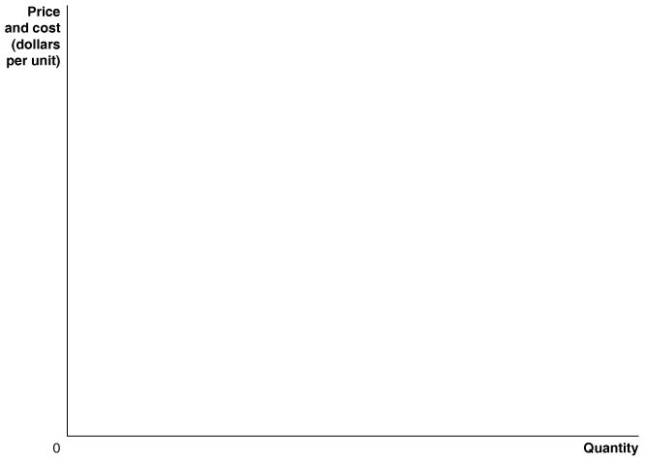

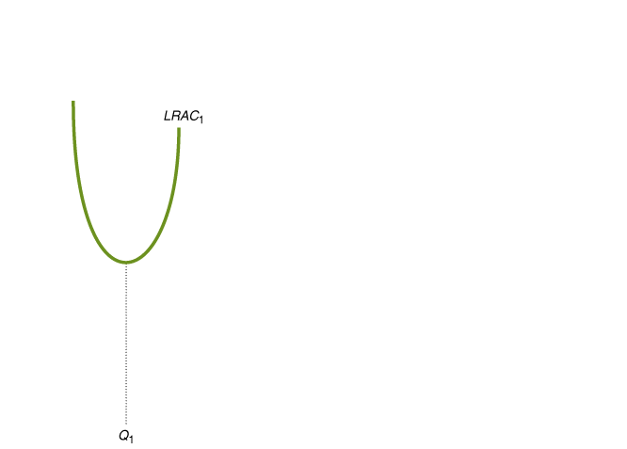
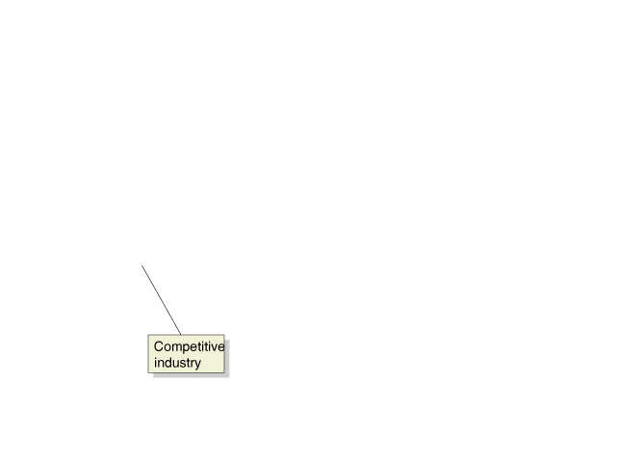
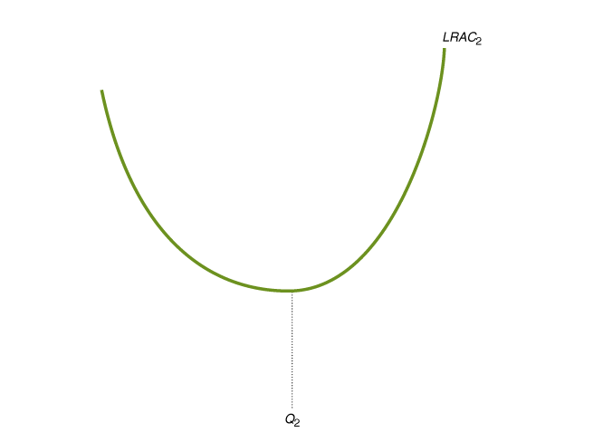
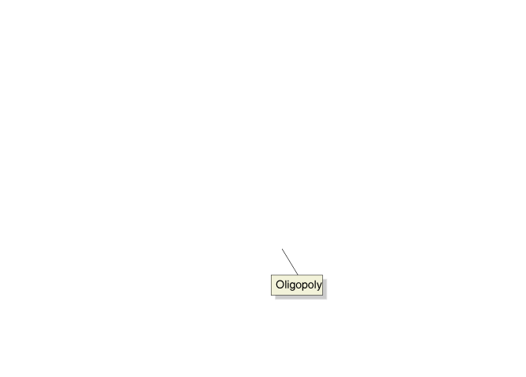
Economies of Scale Help Determine the Extent of Competition in an Industry

Slide 6
Barrier #2: Ownership of a Key Input
If production of a good requires a particular input, then control of that input can be a barrier to entry.
Barrier #3: Government-Imposed Barriers
Patent The exclusive right to a product for a period of 20 years from the date the product is invented.
Licensing Requirements
Tariffs and Quotas

Slide 7
Using Game Theory to Analyze Oligopoly
All games share three key characteristics:
Rules that determine what actions are allowable
Strategies that players employ to attain their objectives in the game
Payoffs that are the results of the interaction among the players’ strategies
Payoff matrix A table that shows the payoffs that each firm earns from every combination of strategies by the firms.

Slide 8
A Duopoly Game: Price Competition between Two Firms
A Duopoly Game: Price Competition Between Two Firms
Sony
$600
$400
MS: $10m
MS: $5m
$600
Sony: $10m
Sony: $15m
Microsoft
MS: $15m
MS: $7m
$400
Sony: $5m
Sony: $7m

Slide 9
Dominant strategy A strategy that is the best for a firm, no matter what strategies other firms use.
Nash equilibrium A situation in which each firm chooses the best strategy, given the strategies chosen by other firms.
Collusion An agreement among firms to charge the same price or otherwise not to compete.
If MS chooses $600, Sony should choose:
If MS chooses $400, Sony should choose:
Sony
If Sony chooses $600, MS should choose:
If Sony chooses $400, MS should choose:
MS

Slide 10
Cooperative equilibrium An equilibrium in a game in which players cooperate to increase their mutual payoff.
Noncooperative equilibrium An equilibrium in a game in which players do not cooperate but pursue their own self-interest.
Prisoner’s dilemma A game in which pursuing dominant strategies results in noncooperation that leaves everyone worse off.

Slide 11
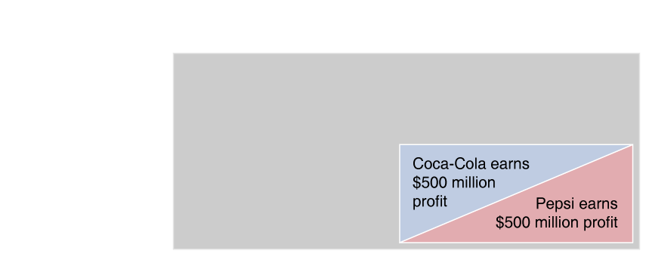
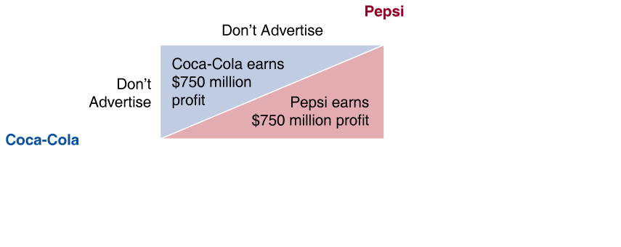
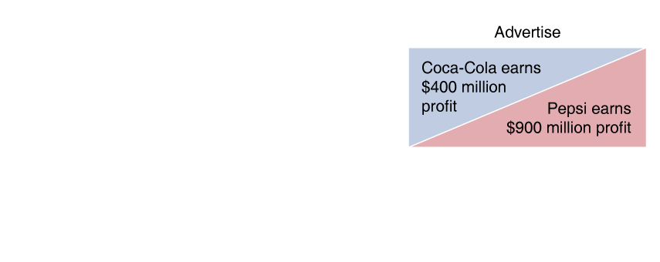
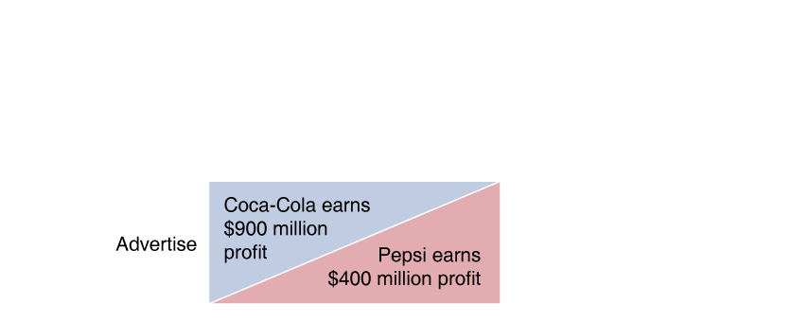
Is Advertising a Prisoner’s Dilemma Game?
Advertising increases a firm’s costs, but attracts more customers.
Key question: Does a firm’s advertising simply attract customers away from other firms in the industry, or does it attract new customers to the industry?
In this example, when a firm advertises it attracts customers from the rival firm, but does not attract new customers to the industry.

Slide 12
Is Advertising a Prisoner’s Dilemma Game?
In this example, when a firm advertises it attracts some customers from the rival firm, but it also attracts customers to the industry as a whole.
Firm X
Don’t Advertise
Advertise
Don’t Advertise
Firm Y
Advertise

Slide 13
Can Firms Escape the Prisoner’s Dilemma?
The games described previously were “one time” games. In reality, these games are often played over and over. That is, they are “repeated games”. How does this change things?
Firms can increase profits if they collude. Explicit collusion is illegal in the US. Implicit collusion, however, may be within the law.
Price leadership A form of implicit collusion in which one firm in an oligopoly announces a price change and the other firms in the industry match the change.
“We will not be undersold!”

Slide 14
A Duopoly Game: Price Competition between Two Firms
Escaping the Prisoner’s Dilemma?
Pizza Hut
High Price
Low Price
D: $1000
D: $500
High Price
PH: $1000
PH: $1500
Dominos
D: $1500
D: $700
Low Price
PH: $500
PH: $700

Slide 15
Cartel A group of firms that collude by agreeing to restrict output to increase prices and profits.
Is collusion guaranteed to be successful in a cartel?
The basic arrangement is restrict output and thus push up the price of the product.
What incentive does this high price give members of the cartel?

